Slide 1
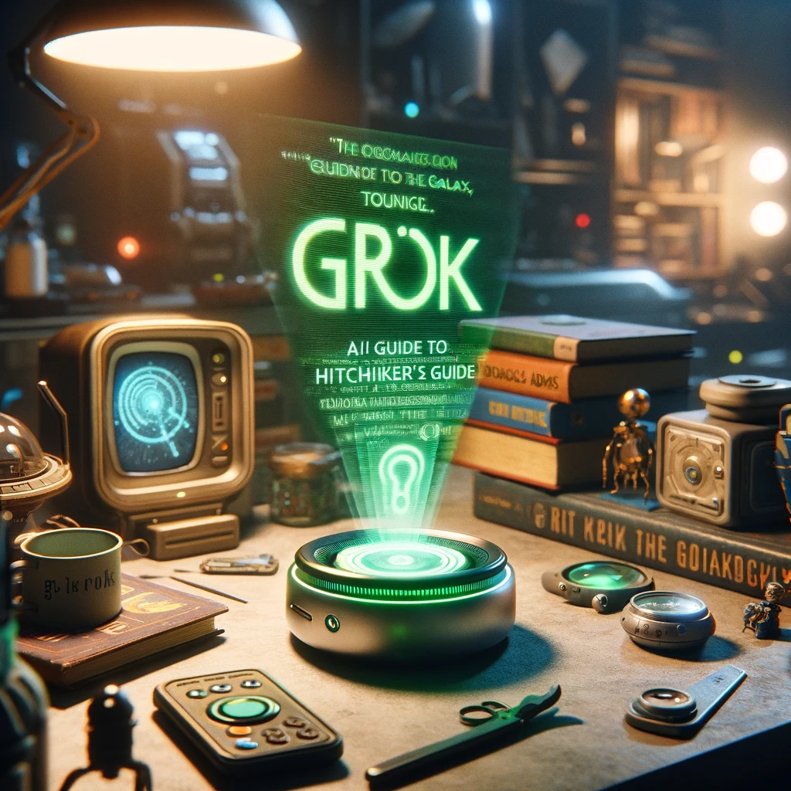

How to really use Grok-1

Slide 2

“Life... is like a grapefruit. Well, it's sort of orangey-yellow and dimpled on the outside, wet and squidgy in the middle. It's got pips inside, too. Oh, and some people have half a one for breakfast.”
- Douglas Adams, So Long, and Thanks for All the Fish

Slide 3
Grok-0
33b
Development
More Development
Grok-1
Unknown
Elon Sues OpenAI
Elon Announces Grok-1 will be opensource
Grok-1 Opensource
314b
Still More Development

Slide 4

Notes:
https://www.spirit.com/

Slide 5
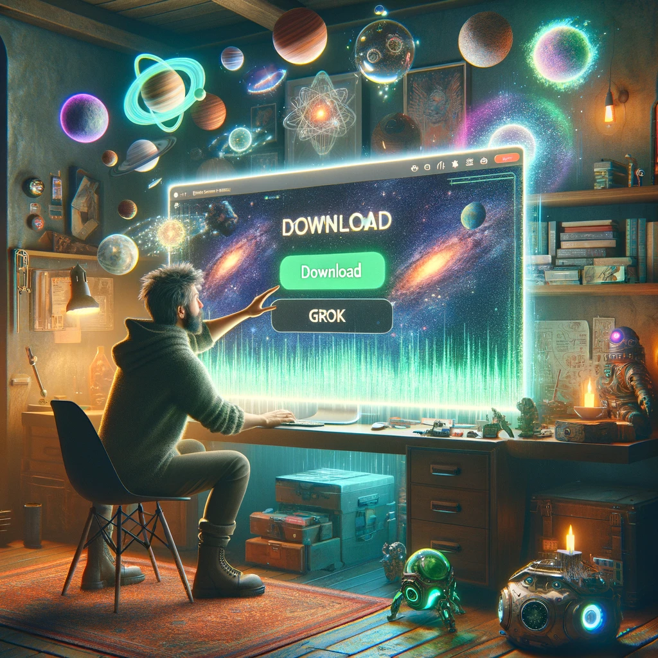
Getting Grok-1

Slide 6
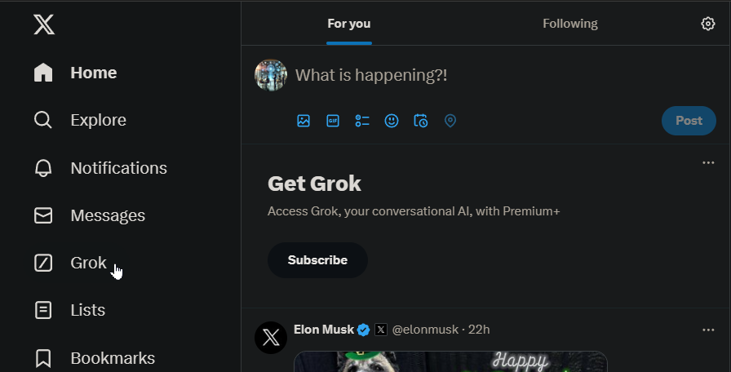
Grok Access
Notes:
https://twitter.com/home

Slide 7
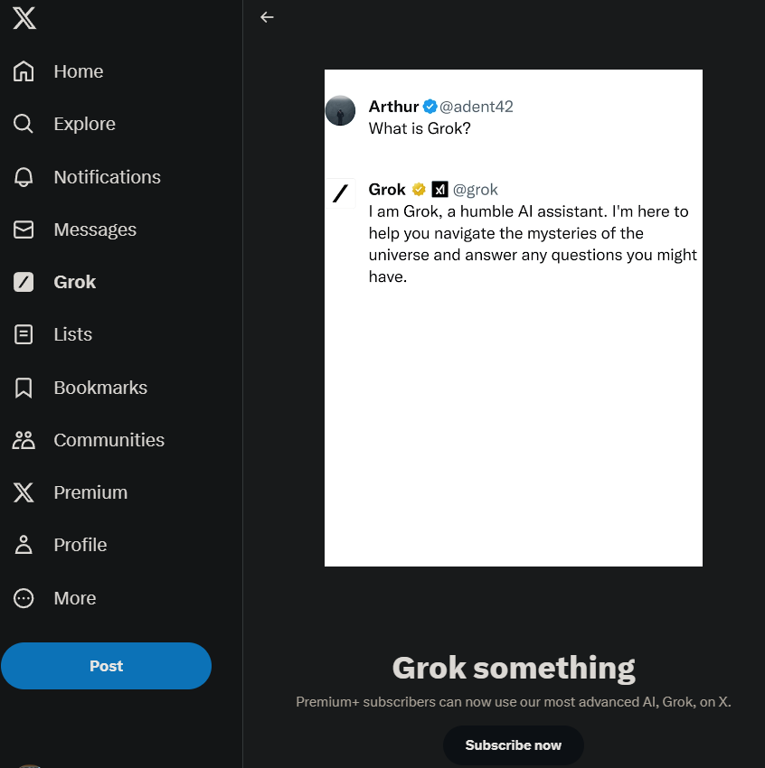

Slide 8
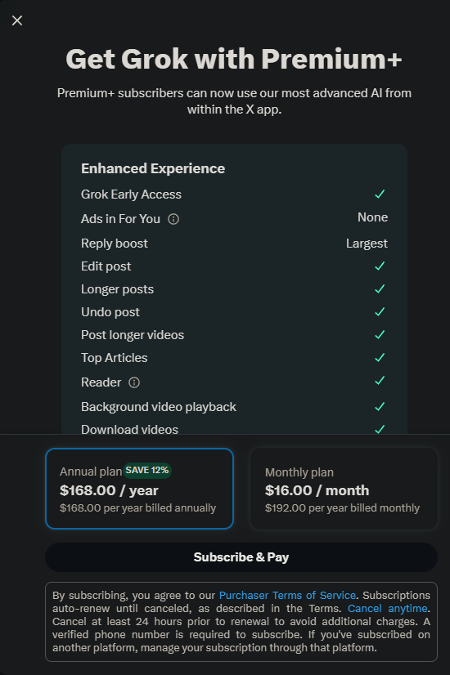

Slide 9
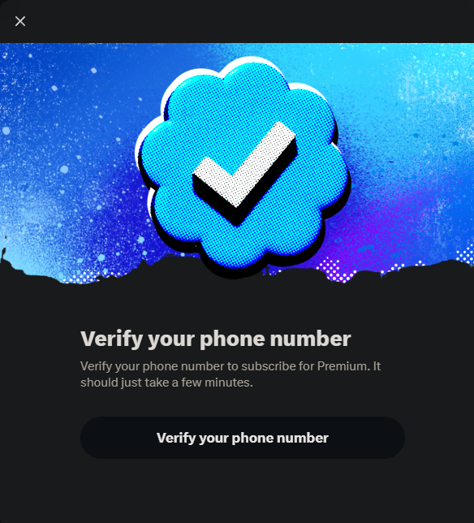

Slide 10
